Slide 1
Introduction to Deep Learning: Algorithms and Their Applications
CDC Short Course
Xiaoming Huo, Georgia Tech

Slide 2
Schedule
8:30-9:30 Lecture 1: Introduction
9:45-10:45 Lecture 2: Course Materials and Resources
11:00-12:00 Lecture 3: Perceptron
12:00-1:15 Lunch break
1:15-2:00 Lecture 4: Neural Network, Software
2:15-3:00 Lecture 5: Convolution Networks
3:15-4:00 Lecture 6: Some Examples
4:00 Adjourn
Online resources: https://github.com/xhuo17/DL2022CDC

Slide 3
perceptron
multilayer
Outline
• Single Layer Perceptron
• Decision Boundary
• XOR is hard
• Multilayer Perceptron
• Layers
• Nonlinearities
• Computational Cost

Slide 4
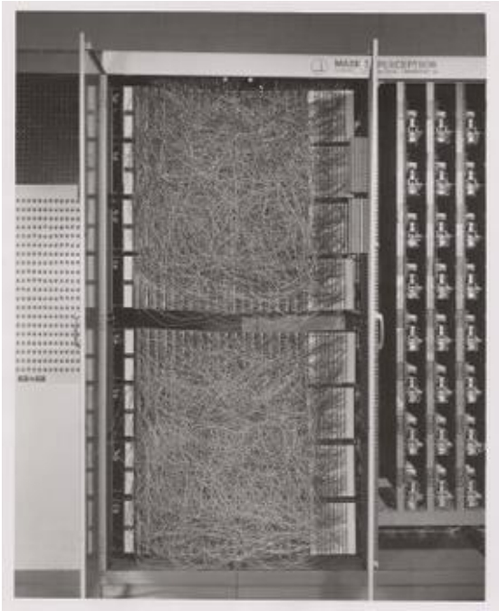
perceptron
multilayer
Perceptron
Mark I Perceptron, 1960 (wikipedia.org)

Slide 5
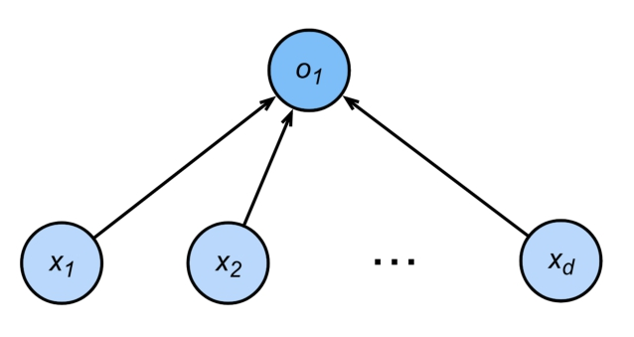
perceptron
multilayer
Perceptron
•

Slide 6
perceptron
multilayer
Perceptron
• Given input
x
, weight
w
and bias
b
, perceptron outputs:
• Binary classification (0 or 1)
• Vs. scalar real value for regression
• Vs. probabilities for logistic regression

Slide 7
perceptron
multilayer
Perceptron
Ham
Spam

Slide 8
perceptron
multilayer
Training the Perceptron

Slide 9
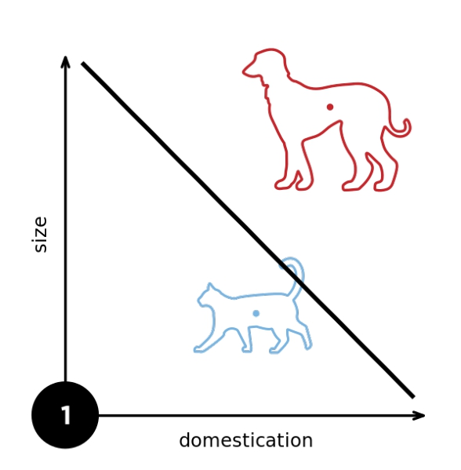
perceptron
multilayer
From wikipedia

Slide 10
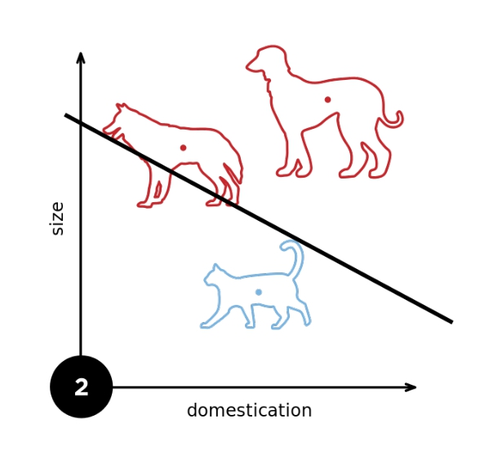
perceptron
multilayer
From wikipedia

Slide 11
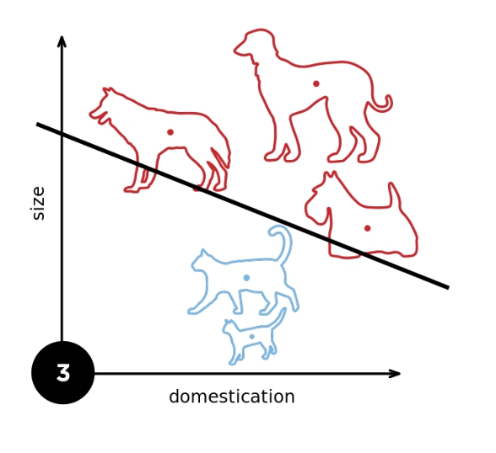
perceptron
multilayer
From wikipedia

Slide 12
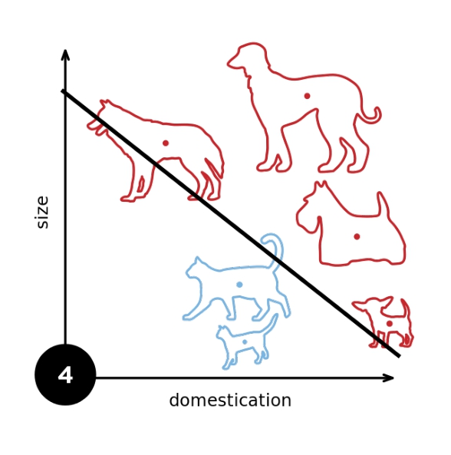
perceptron
multilayer
From wikipedia

Slide 13
perceptron
multilayer
Convergence Theorem
• Radius r enclosing the data
• Margin ρ separating the classes
for
• Guaranteed that perceptron will
converge after
steps

Slide 14

perceptron
multilayer
Consequences
• Only need to store errors. This gives a compression bound for perceptron.
• Fails with noisy data
do NOT train your avatar with perceptrons
Black & White

Slide 15
perceptron
multilayer
XOR Problem (Minsky & Papert, 1969)
The perceptron cannot learn an XOR function (neurons can only generate linear separators)

Slide 16
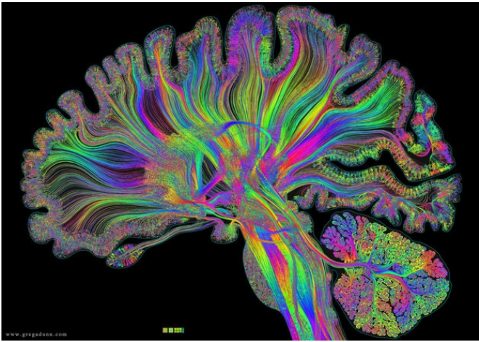
perceptron
multilayer
Multilayer
Perceptron

Slide 17
perceptron
multilayer
Learning XOR
1 2
3 4

Slide 18
perceptron
multilayer
Learning XOR
1 2 3 4
+ - + -
+
+
+
-
-
-
-
+
product
1
3
2
4

Slide 19





perceptron
multilayer
Learning XOR
1 2 3 4
+ - + -
+
+
+
-
-
-
-
+
product
1
3
2
4

Slide 20
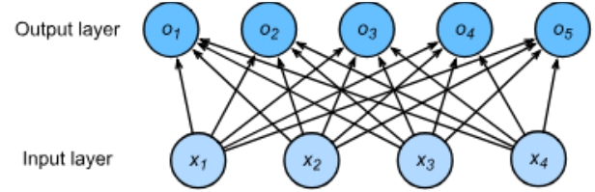
perceptron
multilayer
Single Hidden Layer

Slide 21
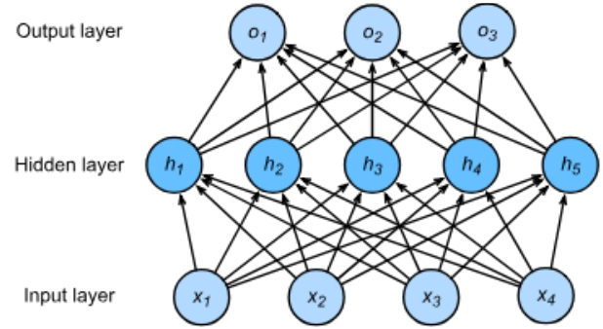
perceptron
multilayer
Single Hidden Layer
Hyperparameter - size m of hidden layer

Slide 22

perceptron
multilayer
Single Hidden Layer
σ
is an element-wise activation function

Slide 23
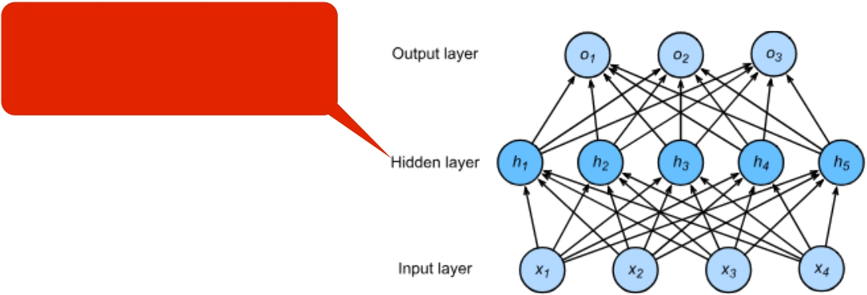
perceptron
multilayer
Single Hidden Layer
Why do we need an a
nonlinear activation?
σ
is an element-wise activation function

Slide 24
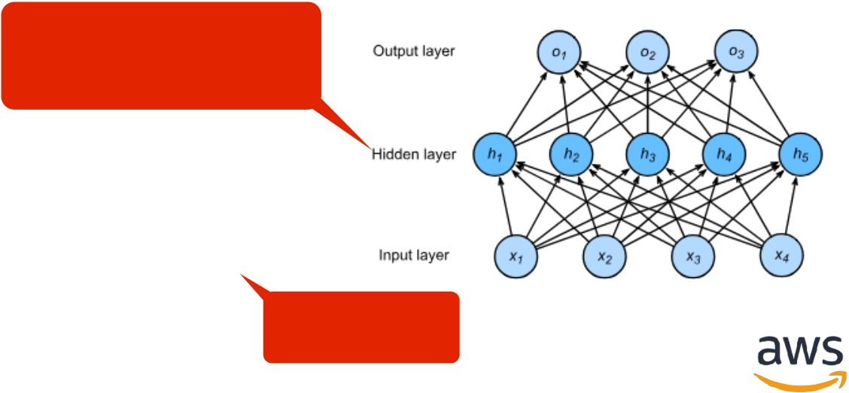
perceptron
multilayer
Single Hidden Layer
Why do we need an a
nonlinear activation?
Linear …

Slide 25
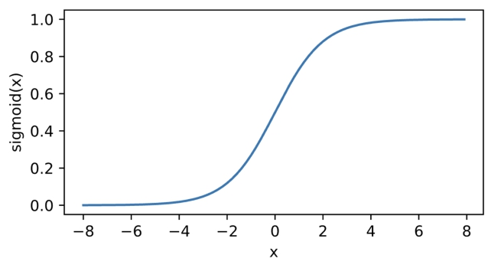
perceptron
multilayer
Sigmoid Activation
Map input into (0, 1), a soft version of
1
sigmoid(x) =
1 + exp(−x)

Slide 26
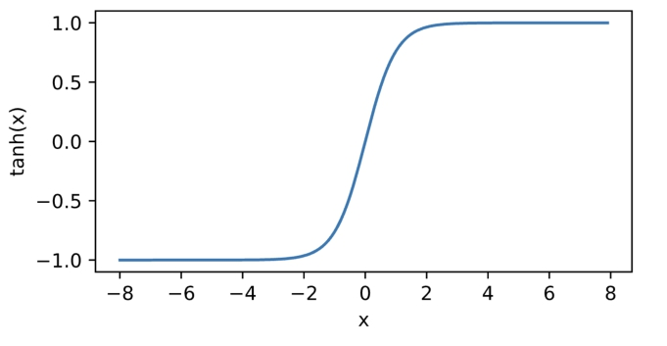
perceptron
multilayer
Tanh Activation
Map inputs into (-1, 1)
tanh(x) = 1 − exp(−2x)
1 + exp(−2x)

Slide 27
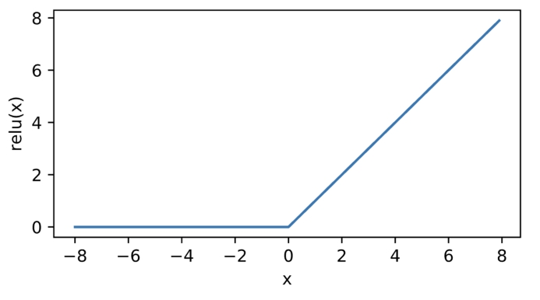
perceptron
multilayer
ReLU Activation
ReLU: rectified linear unit
ReLU(x) = max(x,0)

Slide 28

perceptron
multilayer
Multiclass Classification

Slide 29
perceptron
multilayer
Multiclass Classification

Slide 30
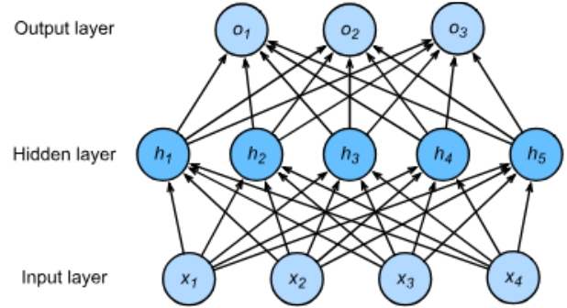
perceptron
multilayer
Multiclass Classification
• Hidden
• Output

Slide 31
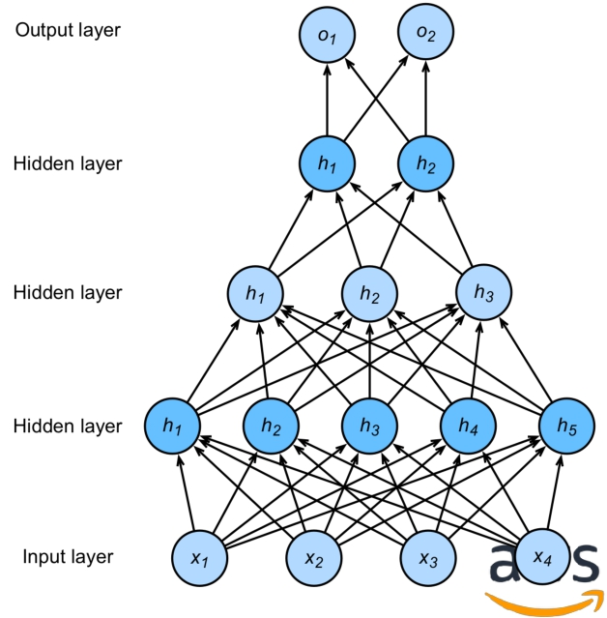
perceptron
multilayer
Multiple Hidden Layers
Hyper-parameters
• # of hidden layers
• Hidden size for each layer

Slide 32
perceptron
multilayer
Summary
• Perceptron
• Simple updates
• Limited function complexity
• Multilayer Perceptron
• Multiple layers add more complexity
• Nonlinearity is needed
• Simple composition (but architecture search needed)

Slide 33
Schedule
8:30-9:30 Lecture 1: Introduction
9:45-10:45 Lecture 2: Course Materials and Resources
11:00-12:00 Lecture 3: Perceptron
12:00-1:15 Lunch break
1:15-2:00 Lecture 4: Neural Network, Software
2:15-3:00 Lecture 5: Convolution Networks
3:15-4:00 Lecture 6: Some Examples
4:00 Adjourn
Online resources: https://github.com/xhuo17/DL2022CDC

